Slide 1
Samsung QuickShare Project

Slide 2
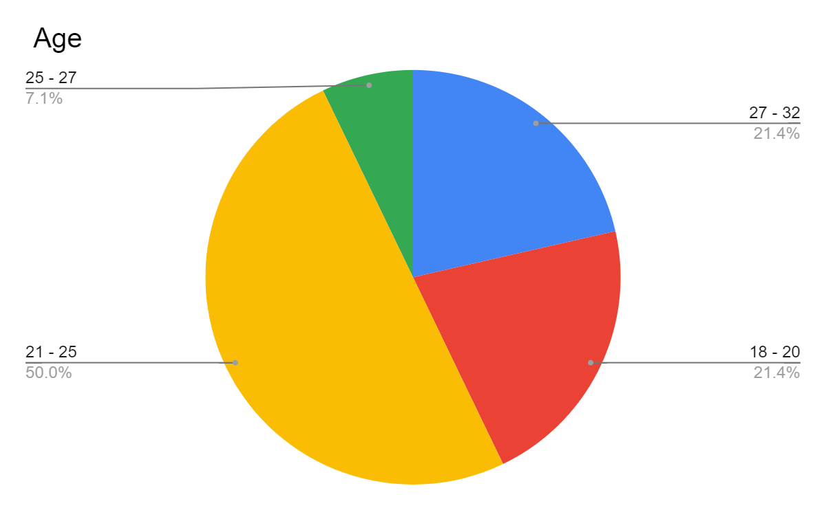
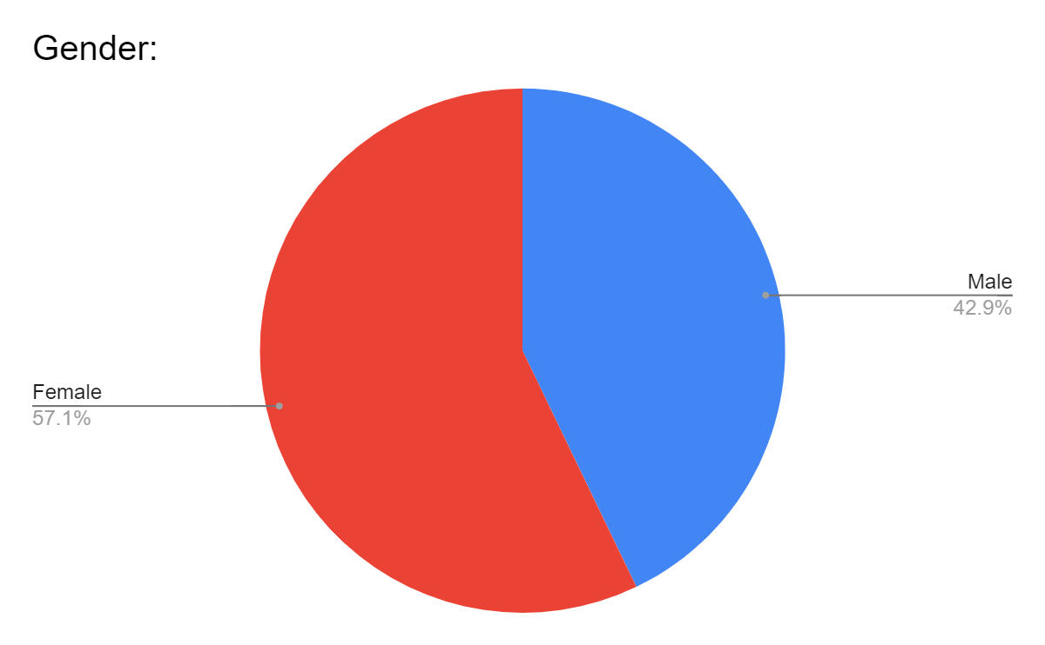
Total interviews taken -Senders+Receivers-9+7=16

Slide 3
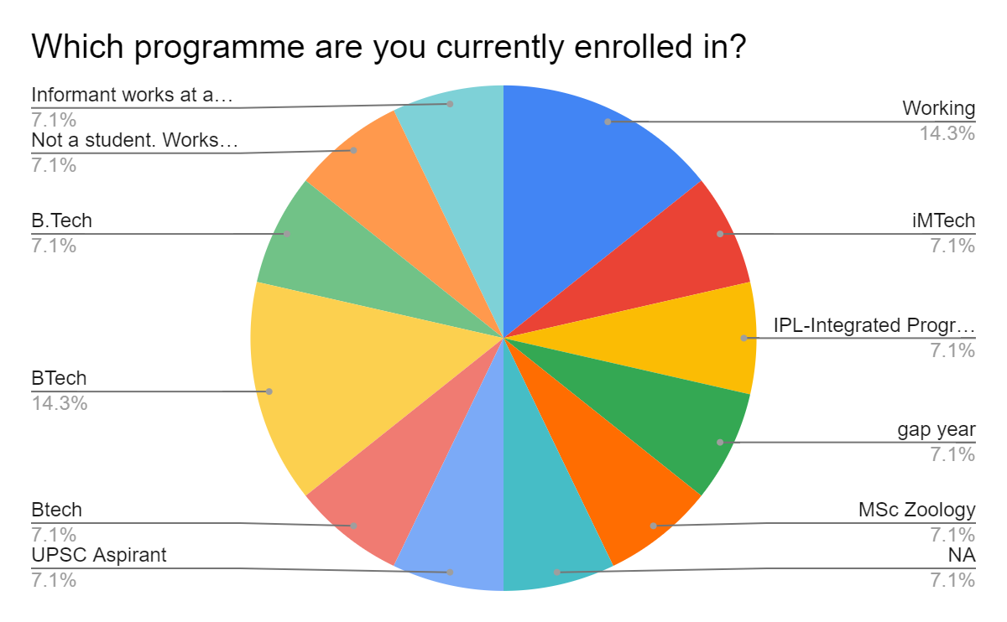
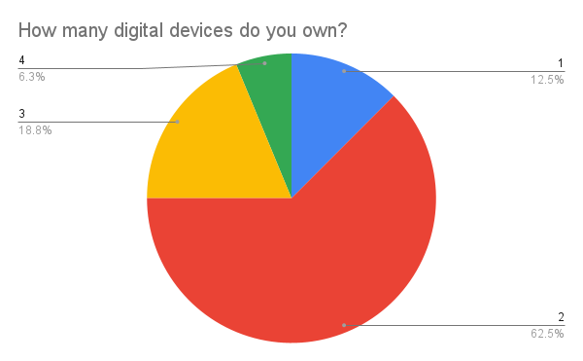

Slide 4
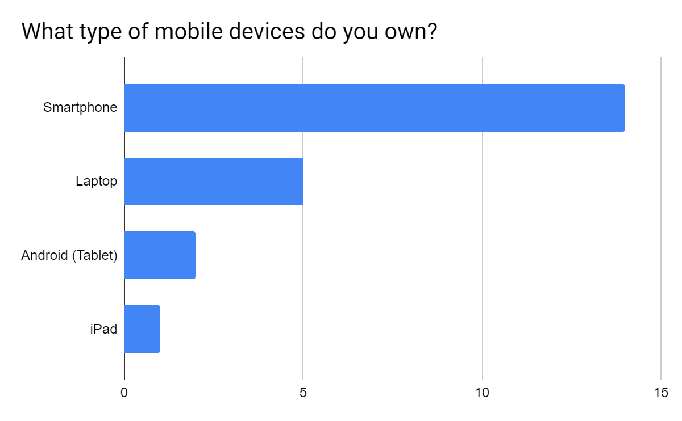
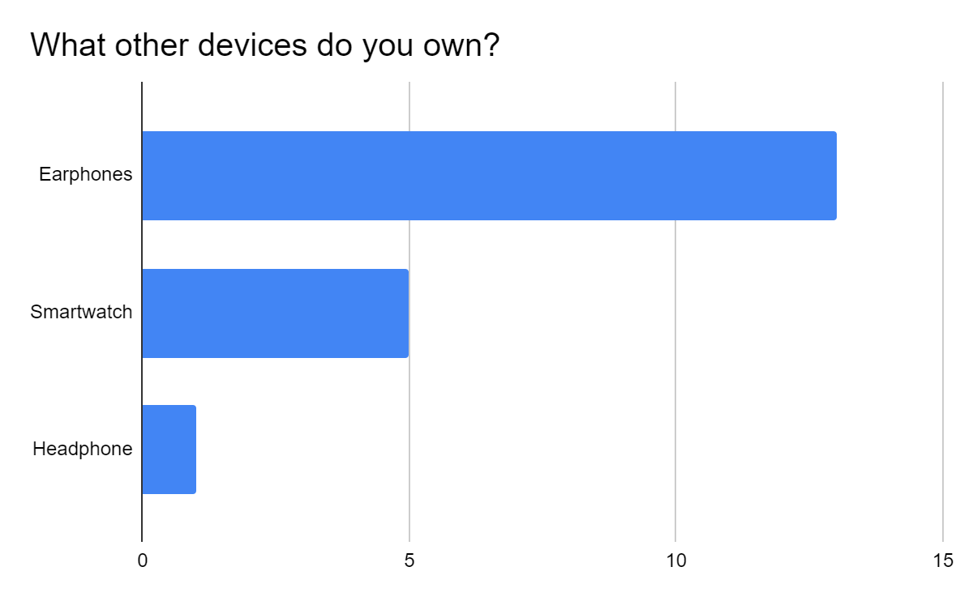

Slide 5
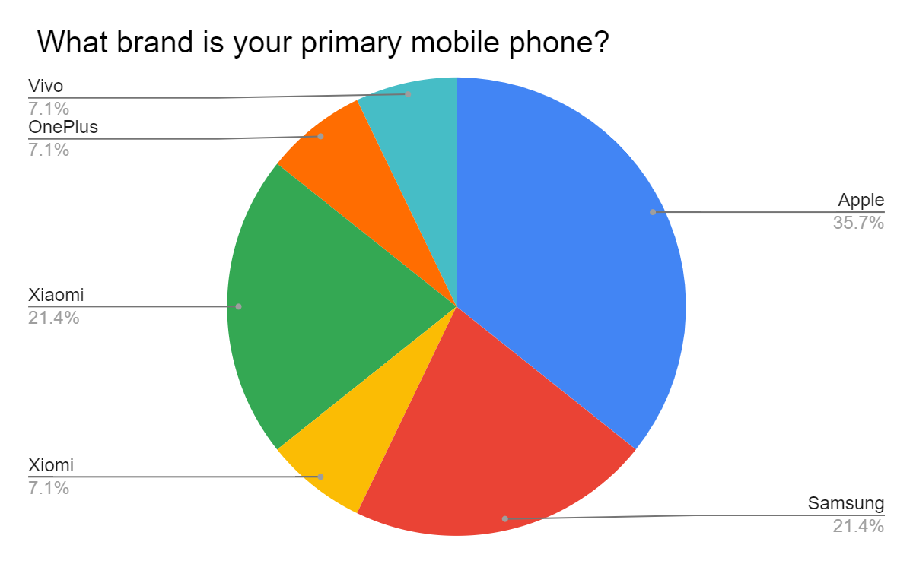
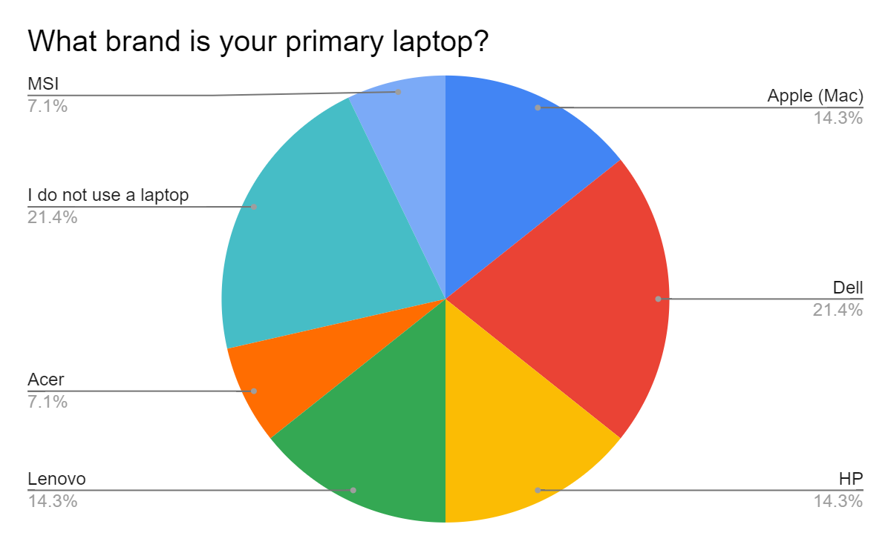

Slide 6
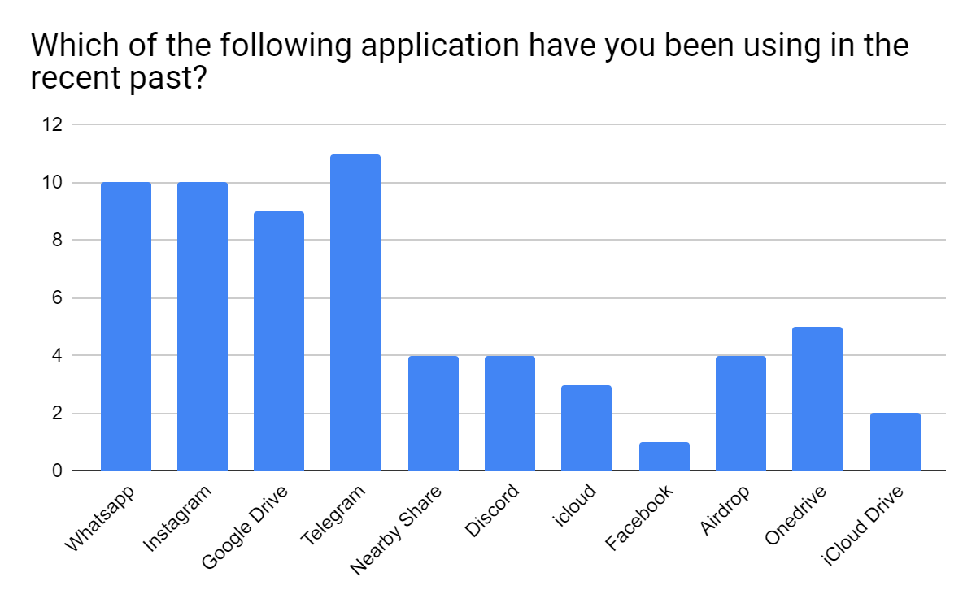

Slide 7
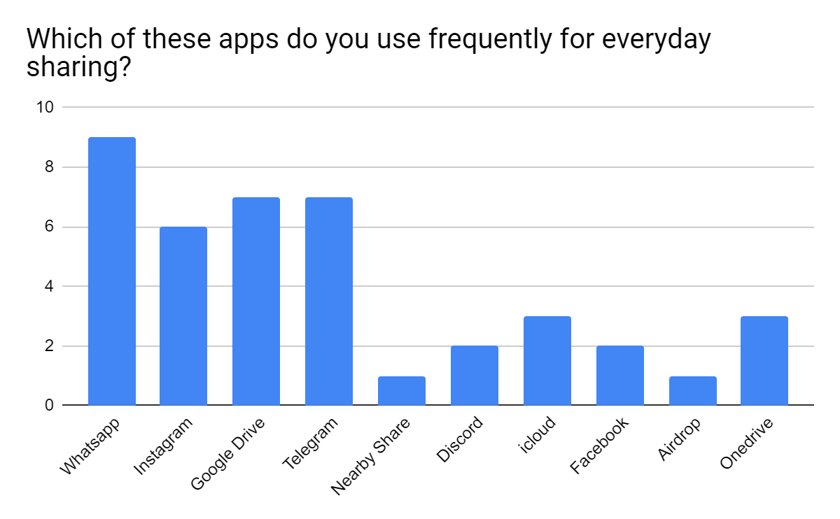
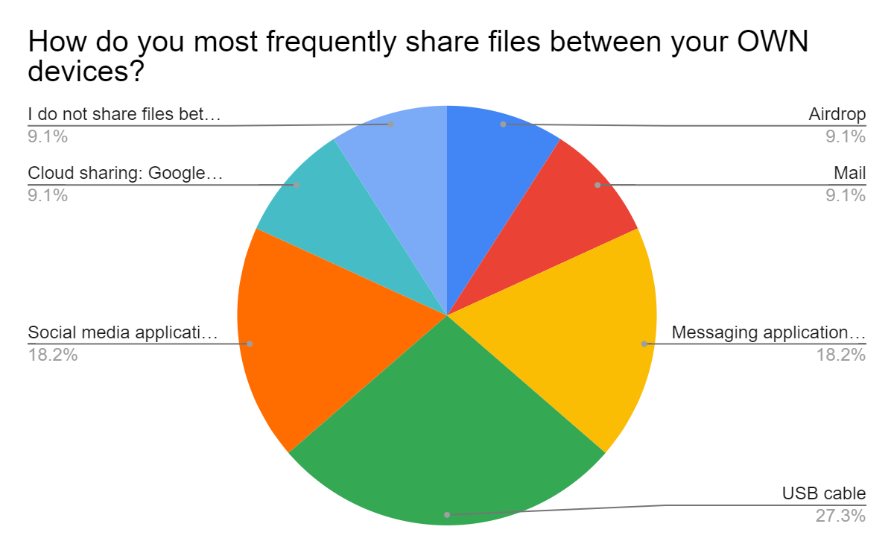

Slide 8
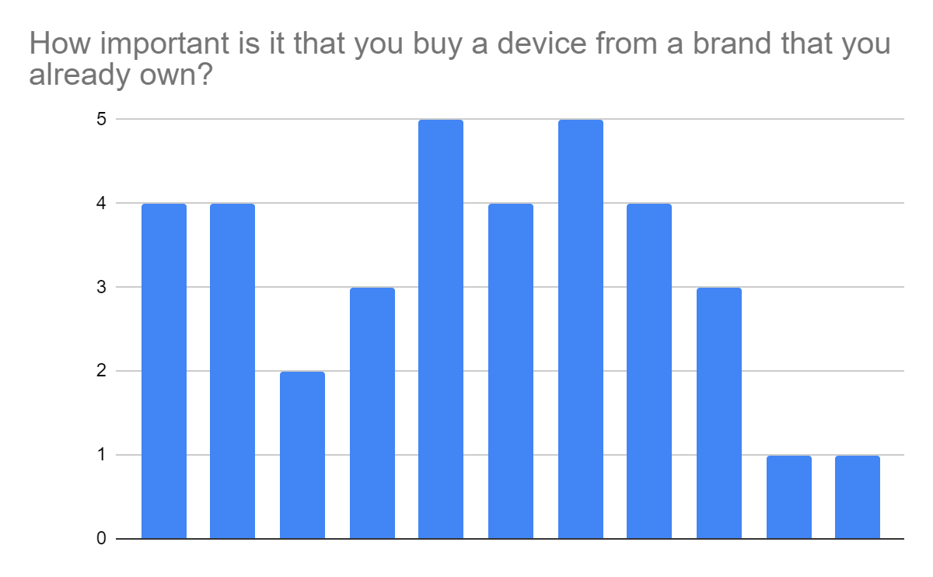
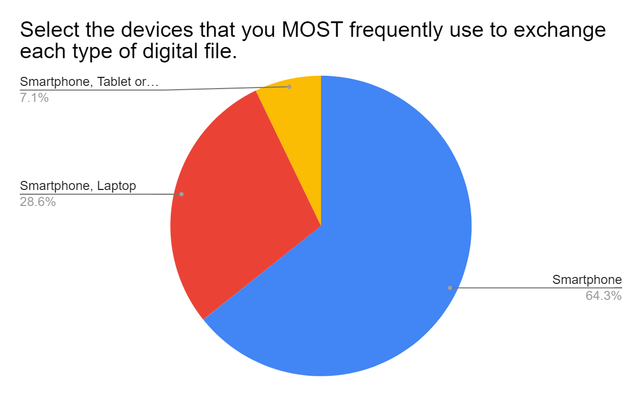
1 - Negligible Importance
2-Low Importance:
3-Neutral Importance
4-High Importance
5 -High Importance

Slide 9


Sender’s Demographics
9
INTERVIEWS
44%
56 %

Slide 10
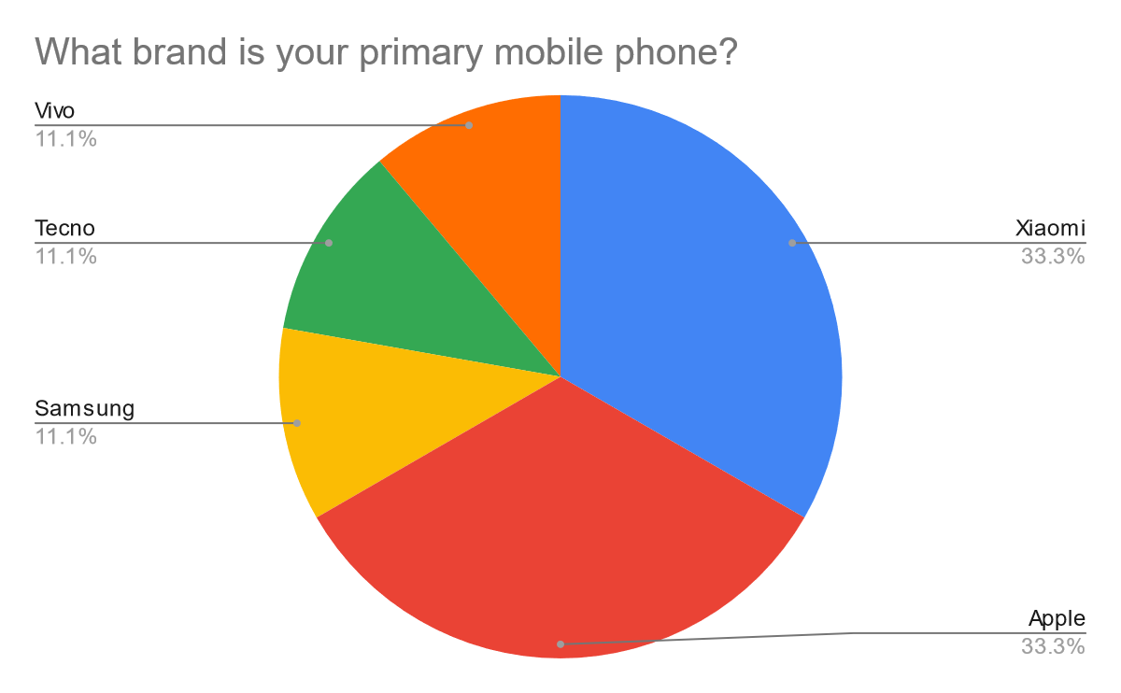
Sender’s Demographics
9
All participants own a smartphone
3 of them had an Apple device
1 had a Samsung device.
1
Owned an Apple iPad
5
Had a smartwatch

Slide 11
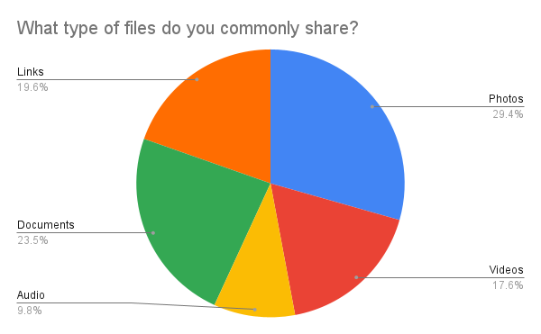
FILE TYPE
DOCUMENTS
“Like even if there is this excel file that I'm making, I'll convert it to PDF or document."-P4.1
"So what I prefer is, I make a PDF I click pictures, I scan it, I make a PDF out of it, and then I send it.
Most probably on WhatsApp”-P2.4
PHOTOGRAPHS
"Yes I mostly use Facebook messenger and whatsapp to share photos and videos. Depends on who in my surroundings uses what, I use messenger of whatsapp+
Uses Whatsapp more for her work calls"-P4.1
"I share Photos in the WhatsApp Groups, with friends and family as everyone uses only WhatsApp to share photos ."-P2.4

Slide 12
“I transferred a file and it was an image file that I needed on my other device. So it was sent using WhatsApp. So through WhatsApp, I had some documents that I had to send.”- P4.4(Xiaomi user)
“I use Samsung ,both on my tablet and phone and I use the same Email-IDs on both of them .Thus,if I share I can view directly in both of them”
-P4.3(Samsung user)
Interoperability(Own devices)
"If it's personal file sharing, like between, sharing between my devices, my phone, my iPad, my laptop.
Airdrop is a nice thing which Apple does right"
-P2.2(Apple User)
Uses two devices: Poco & Vivo _ "I use two phones, one POCO and another one is ViVo, POCO one I use largely to make a hotspot WiFi connection for myself"
-P4.2(Vivo and Poco User)

Slide 13

"If people were close to me and I know them very well, I prefer using WhatsApp more and in the more formal cases like colleagues and all that, I prefer email because they might not have my WhatsApp number" - P4.4
Mode:
Internet Based
Group
Sharing
"WhatsApp is very convenient one because everybody has it and like it's easy to just, I would say ease of access is one of the reason and second, it's the most heard of platform like I haven't heard of other platforms as much as WhatsApp."-P2.3
"Yes I mostly use Facebook messenger and whatsapp to share photos and videos. Depends on who in my surroundings uses what, I use messenger of whatsapp" + Uses Whatsapp more for her work calls"-P2.1

Slide 14


“I use Telegram to access movies and share large files because it doesn’t have file size issues and most of my friends use it to find/download movies”-P4.2
"I prefer another way of sharing like Google Drive or something like that, where I'll upload it on my convenience and the receiver will download it on their convenience."-P4.4
Other popular sharing apps
“ I prefer Telegram to share photos with others because it syncs easily and has good quality”-P4.3
“What we do generally is create a new email with a common google drive and then share that email and password for that google drive with everyone. And everybody dumps their material there so that it's there forever for everyone. "-P2.2

Slide 15
“In absence of internet ,I just wait to share files." -P4.3
"I prefer sending it afterwards when I am getting the connection if there is such a problem of no internet " - P4.4
“ I did the same one day from my laptop where I used my charger lead to transfer the file from my phone to that laptop as the internet was not working in college” -P4.3
“I used Airdrop for non-internet mode” - P2.3
"I will prefer InShare for offline mode." -P2.1
"Interestingly, it was for the wedding photographs and all.We had to buy actually a new hard drive for it. The bandwidth wasn't unlimited, right? You had to pay for every byte. There it, then we used, everybody in college used to use something called a Shareit. I mean, everybody had an Android phone. So mostly everybody had the ShareIt app on their phone." - P2.2
“When there is no internet connection, they
send it via Bluetooth.Small small file like a single photo i share it through Bluetooth in absence of internet.“ - P4.1
Mode:
Non-Internet Based

Slide 16
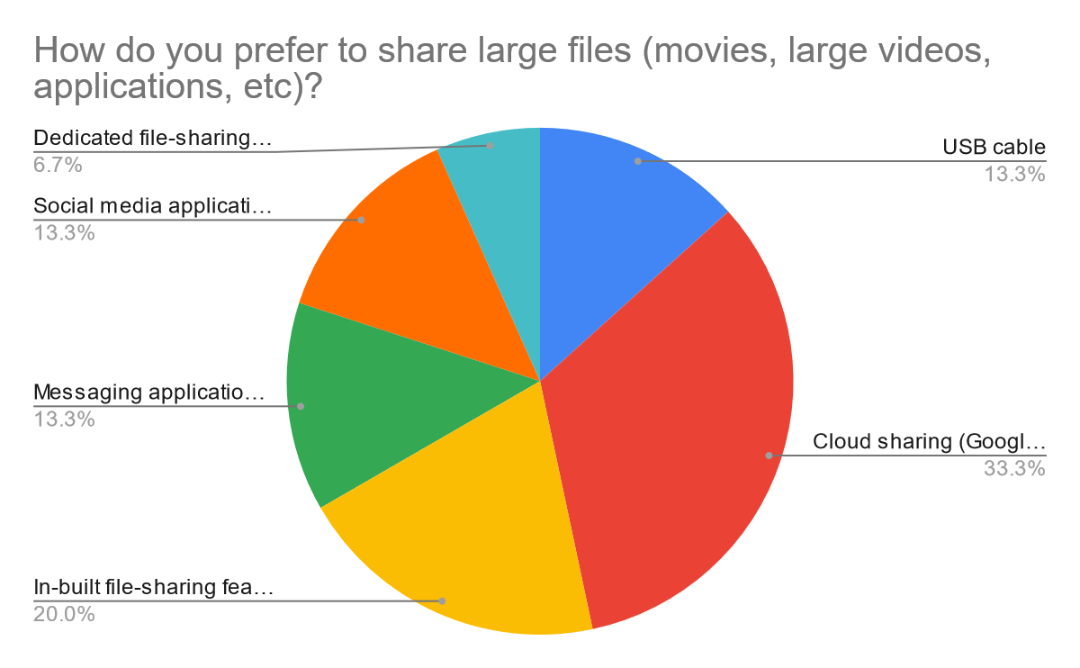
Large files sharing
"I use Telegram only for movies and Whatsapp for sharing photos" - P4.2
"Yes I mostly use Facebook messenger and WhatsApp to share photos and videos." -P4.1
“So what I prefer is, I make a PDF I click pictures, I scan it, I make a PDF out of it, and then I send it.
Most probably on WhatsApp” -P2.1
"We commonly use, maximum we use WhatsApp only. And if someone is not available to take it from WhatsApp, like net issues, we try giving it by, I have also given by sometimes by telegram or once I also get my lead also, our USB lead" -P4.3
"I prefer another way of sharing like Google Drive or something like that, where I'll upload it on my convenience and the receiver will download it on their convenience, so it's a more flexible way to exchange files rather than just sending it on WhatsApp." -P4.4

Slide 17
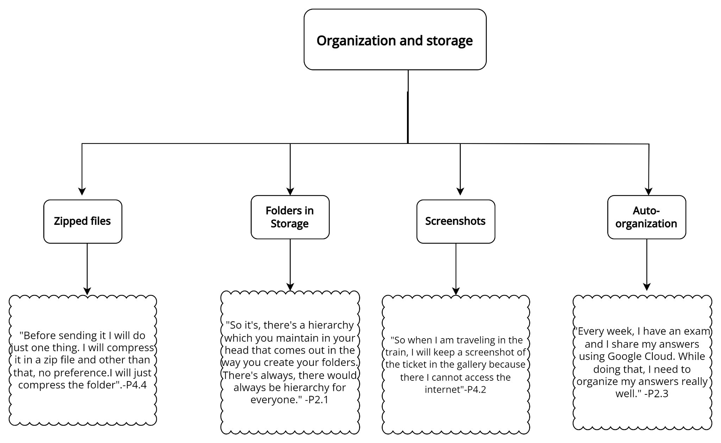

Slide 18
"I will go to my google drive/cloud to see if it has stored some photo/video that I need to access and I have missed that. I will go back to my phone’s google storage to check that."
“Sometimes when i need it and i don't have the picture i just go back to WhatsApp check there only and send it again so like my official documents like aadhar card if I had to send it to someone i'll go and take it from there.
P4.2
P4.3
History
P4.4
P2.4
"I had one such case. In the case of sharing the photo in that case and while I was sharing it on Google Drive I had to cross check whether the video file that I intended to send was sent or not."
“I go back and see the shared files with my friends or family on WhatsApp”

Slide 19
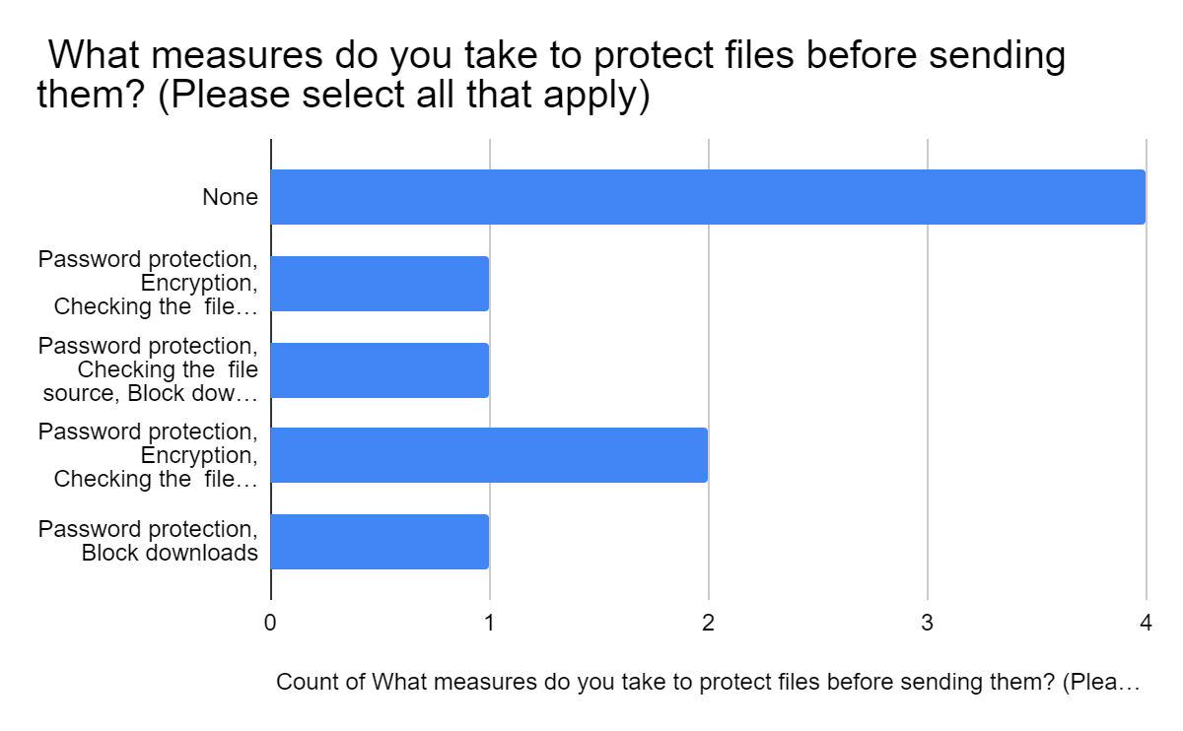
Security
Most of the participants did not do anything about file security because most of them did not have concern regarding it .
"I don't have any concern with respect to security."- P2.1

Slide 20
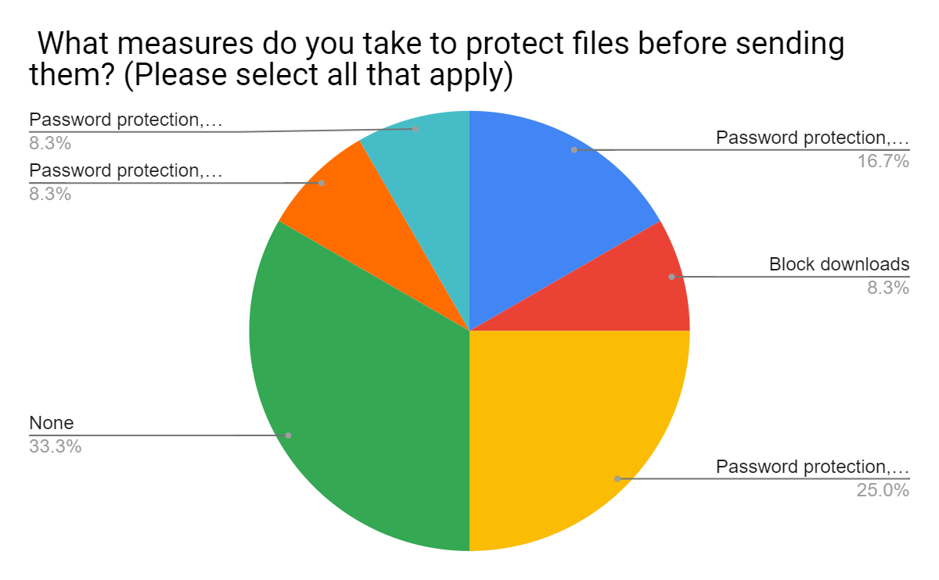
"If we have to keep something safely in the phone I make a different folder and keep it inside file.
"- P4.1
"If I have to send something like a bank detail file, I will definitely do it as a Password protected file" P4.4

Slide 21
"I sent really important documents through WhatsApp. And if it things like Aadhaar Card, I call and verify if receiver has received it. Also, I don't share important documents with unknown people."-P2.4
"It's just phone password in terms of security to count on."
"Like, yeah, in tech, I mean, there's something like vault, right, to secure your applications. So in, if in our app, there's a vault section, wherever I drag and drop a file to that vault, that vault cannot be opened without my explicit password which I have set for, set for that vault. "-P2.3

Slide 22
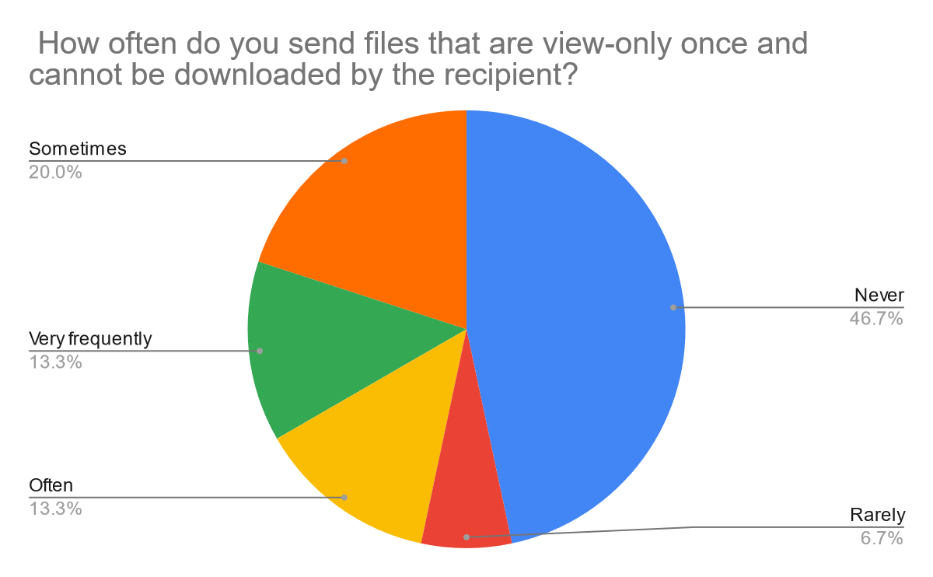
“Yeah, One Time View files I often have used many times. For privacy reasons, one. Secondly, if you don't want that person to see that many times and laugh about it, I'll just send it once. “P2.6

Slide 23
Privacy
"I don't know anything with respect to privacy."-P2.1
"If I have to send something, some location or something to a delivery executive, automatically he gets my number."-P2.3
"If I have to share a file with someone I don't know, I will use Xender" P2.2
"Sometimes I use View Once for images and videos on WhatsApp. It is also convenient and saves space for both"- P4.4

Slide 24
"I don't want to share my personal mobile number with that guy who is sitting in the shop. So I do have, I have an email there, which I just use for this kind of purposes where I'll just upload that file to my email and then I'll send that to his, his email. so that he can just download it and print it out for me."P2.3
“Okay, this may sound really funny, okay. So, in our campus, they have this thing of relative grading. So, if you're sharing a file with me, and there are notes, okay, and there are few people who keep this WhatsApp, uh, this password thing. Like, I'm sharing it to you, I'm giving you the password. Don't say it to another person, or if someone takes it from your mobile, they won't know the password.”P2.6

Slide 25
Urgency
" Most preferred is WhatsApp due to the ease of access and convenience” -P4.2
"If I need to get in touch with someone urgently, I will call them" - P4.3
"At that time I was not able to do anything because the person who I needed to send the document to was not nearby. Otherwise I would have used the third party app like ShareMe or something like that. At that time I was not able to help"-P4.4
"I use WhatsApp only."-P2.1
"If it's a sensitive thing, but a very small thing, I'll share it on WhatsApp. And I'll delete it from my side and ask them to delete it once they use it, right? If it is a big thing, then I'll put it in my drive. And I'll share the drive with them."-P2.1
"I mostly have to share answers ungently. And if I need anything from my mentors, I directly call them and they send over the necessary documents through Telegram"- P2.3

Slide 26
Quality
"Going out with friends, sharing pictures, which we clicked. Quality gets degraded in WhatsApp. But there are very Instagram savvy people who want the raw photo, So I prefer Google drive for it."-P2.1
"If it's like in a proper event or something that we clicked photographs, then I would want it to go in good original quality."-P2.3
"Quality of files, specially documents, is very important to me. As I am preparing for UPSC, I generally share study materials and I need good quality images and uncompressed Documents to read through"-P2.4

Slide 27
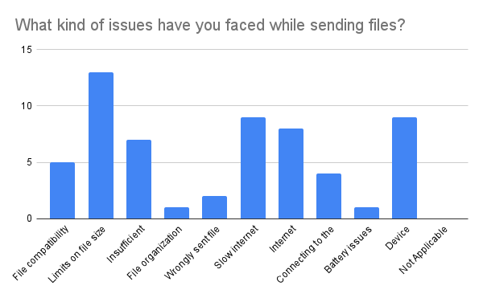
Errors/Issues
Most of the errors that were reported by participants were regarding limits on file size.
Slow internet and device related issues were the second most reported errors.
Battery issues,wrongly sent file and file organization related errors were the least reported.

Slide 28
Errors/Issues
“I was actually not sharing. I was asking someone to send me a PDF file. I was having it previously in my phone, but it was not opening. And when someone was sending me, it was not even coming. It was not the opening like the file was not that user not found you have to ask again to send the file so we again asked that person to send the file.”- P4.3
"If an error comes up while sharing files with my friends, we wait and will share the movie later or something. It's not such a big issue because it's just us friends" - P4.2
"In Apple, you can do a family storage. So, I mean, let's say your household of three to five people, you pay 75 rupees a month and everybody can use that drive space, but it's still, so in software now it's called tenancy. You're maintaining your tenants. Right. One person, second person, third person, all these are tenants. So their data is segregated, but the place where it gets stored is big. So there's a tenancy maintained, but you can still, it's private for even the members. If that thing could be done in YouTube, I mean, not YouTube, Drive, Google Drive, it's great.”- P2.1
"Due to internet connectivity a lot of times, otherwise not really.If the Wifi is not working, I switch to internet, like data. If that's also not working, maybe I just restart my phone. "- P2.3

Slide 29
Receiver's Demographics
7
INTERVIEWS
42.8%
57.2%

Slide 30




INTERVIEWEE | MOBILE BRAND
P(1.3) | Samsung
P(1.6) | Apple
P(1.7) | Apple
P(1.8) | Samsung
P(3.5) | Xiaomi
P(3.6) | OnePlus
P(3.7) | Samsung
Samsung Users: 3
Apple Users: 2
Xiaomi Users: 1
OnePlus Users: 1

Slide 31
People and Context
In work-related contexts, email is preferred over chat to share files because it allows for keyword search.
Separate google drive accounts created for different needs: family photo archives, fan google drive, friends, etc.
Google Drive is preferred for the group projects
Apple user, working professional, uses Zoho mail and Cliq in work contexts
Formality as in … if it’s like a guideline thing that you’re going to come back to. Then it’s better to have it in a consolidated email.
P1.7
P1.7
Apple user, student, uses different Google Drive accounts for different purposes
I have a separate google drive account for friends, family, k-pop concerts, photographs….I sort all my photos and files everyday
P1.6
Samsung user, Student
For our group project, we create a Google Drive link and upload all the necessary files to it. This is because we need to read papers and share them collaboratively.
P3.7

Slide 32
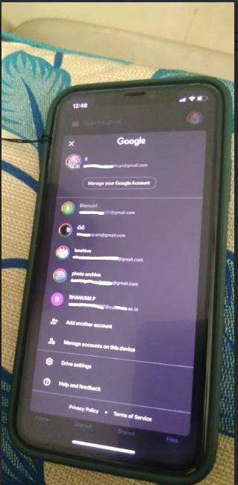
The different Google Drive accounts of P1.6, for different purposes

Slide 33
Interoperability
NFC posed challenge while transferring files between a Samsung and Pixel phone
.
Google Photos(App) is difficult to be use on Apple, So preferred to be opened on Chrome.
Data Transfer using cables still preferred by the users
Ex-Samsung user.
Challenges with interoperability with different devices
My brother had a Pixel, I had a Samsung and we needed a large video file and I don't remember which app I used, but it was not seamless, it wouldn't recognize the device and when we send the file, it would stop midway, so you had to do it a couple of times.
P1.7
Samsung User,
Student
I transferred a movie file from my laptop to my smartphone using a data cable. I did this to watch the movie while travelling.
P3.7

Slide 34
Internet Absence
Usage of quick share and Bluetooth appeared during lack of internet.
Numbers of errors faced while transferring files on non-internet methods, were largely around pairing and device compatibility.
Bluetooth is used in few cases but not appreciated.
Samsung user, Student
Today, I used Quick Share to receive a file from my classmate because the Wi-Fi network is not available in our hostel.
P3.7
Apple user, has difficulty sharing using Bluetooth when internet is poor.
I think Bluetooth is never hassle free anyway, yeah, it's still like sometimes it recognizes the device, sometimes it doesn't
P1.7

Slide 35
Group Sharing and Bulk Sharing
After a group trip, Google Drive or Photos are useful to share & compile pictures
WhatsApp dominates in the group file sharing among the majority
Apple user, uses Google Photos to get files after group trips, but finds it difficult to use and access
“It's a shared album and everybody puts their own images, uploads them there…oh, it's Google Photos actually.
So in Apple, you can't upload it through the app, so I have to open it through the Chrome browser and then select only 20 images and remember what 20 images I selected, because it doesn't load.”
P1.7
OnePlus user,
Student belong to Gen Z who prefers Discord over other messaging platforms
I use Discord often. We use one server for studying, gaming everything. There are different channels for each activity. For studying there's a separate voice channel, for gaming there's a separate voice channel.
P3.6

Slide 36
Specific features of other Application
Respondent noted that Scheduled sharing is useful, in which Tumblr is preferred over Twitter, due to its free services
Keyword Search feature on WhatsApp was found helpful to make old files accessible.
OneDrive appeared convenient for big files for both sender and receiver.
Apple user, K-Pop fan, uses Twitter and Tumblr to access concert video links
You pay on Twitter, you can schedule tweets, but on Tumblr you don’t have to pay, and you can schedule a tweet for any time.
P1.6
OnePlus user,
Student
Discord gives you an option to stream from YouTube directly. The integration is built in to the app. They give you an option for Watch Parties, so it's very convenient. The connection is pretty good. There's no lag or any such disturbance.
P3.6
Samsung user, Student
“OneDrive is way easier, especially for like bigger files ….Suggests potential errors with other methods for larger files”
P1.8

Slide 37
Organisation and Storage
Important file are often secured in PC or hard disk, in that case transfer to Drive less frequent. And Instagram is also used as archive to store important images.
While taking notes an Apple user prefers to use Google Keep instead of Apple Notes because of space issues (5GB of Apple vs. 15GB by Google).
I used to store it in a separate folder.
I use an SD card if I don't have enough storage otherwise I delete unwanted files.
Samsung user, Student
P3.7
Apple user, student. Uses Google Keep for memos and to-do lists
If I have old notes, I use Google Keep for them, I don’t use the Apple notes….as it uploads directly to the iCloud.
P1.6
Apple user and active Instagrammer Uses Instagram to archive photos.
P1.7
Most images are not important to me, and the ones that are, I post them on Instagram and then I delete them anyway, because then I have the Instagram archive for it.

Slide 38
Organisation and Storage
Users find Not Auto Download storage feature of WhatsApp very effective to avoid unnecessary files to bulk up.
Respondents liked the View once feature to avoid clogging up storage, but it also mean that the image cannot be recovered. They handle it differently.
Apple user, finds ways to store space on her device.
P1.6
On saving storage space while using WhatsApp:
But you have this storage option, right, Not auto download, but like when you set it up, you have an option to say, do you want it to save to your gallery automatically or not. I say no, so it only stays on the chat, it doesn't come to my gallery.
Apple user,
Uses one-time view features to exchange photos with friends
P1.7
When P1.7 wants to store a one-time view picture, she informs the receiver (out of courtesy). "I’II just send it and I give a disclaimer that I'm sending this picture because I like it and I would like to look at it again. For example, if there are pictures of my food that I want to look at again. "

Slide 39
Quality
Nearby Share as an alternative for file sharing
Links are created to high quality files and send on regular messaging apps
Samsung user, Student with limited data
P3.7
Quality matters, so I use Nearby Share for file sharing. I will prefer Original files for important official documents and images
Xiaomi user, student
P3.6
I prefer original, high-quality photos, use Google Photos link to share. But usually, I just share photos on WhatsApp and Discord.

Slide 40
Privacy and Security
While receiving files from strangers WhatsApp is preferred over AirDrop, as it feels more familiar and secure.
Nearby Share helps to maintain privacy while transferring files with strangers
Google Drives/Mail’s Auto Safety checker is well trusted.
"If he [stranger] sends me an image through WhatsApp, I can't see how that can be like corrupted,. I think it will filter out any viruses., I feel uneasy AirDropping with them, because I'm not familiar with that function. WhatsApp feels like home, I’m comfortable with it."
Apple user, working professional.
P1.7
Xiaomi User,
student
P3.5
I think if I use a nearby share, I feel it is more safe than using WhatsApp and telegram. Because my number, my contact number is not sharing to them. I'm not sharing my contact number.
Apple user, K-Pop fan, downloads concerts through G-Drive links - perceived security
P1.6
"G drive is better because of banning sites and stuff (other sites are often Russian and banned, need to use a VPN to access them)...... I usually go for Google Drive, if it says there's a problem, I won't download it"

Slide 41
One Time View
Preference and context of One Time View varies among different participants.
Receivers don't want their gallery to be filled with others' private files.
Recently, I was sent a screenshot of a chat. Say we're doing a project, you want to ask a member whether the format is correct or needs any changes. Anyway, we will keep sending each other the same file repeatedly. So I don't want to save these images on my phone. So one-time view is useful in that context.
P3.6
OnePlus user,
Student
It's like when someone don't want to show or say his or her data in another person's device. They prefer sharing the data via one's view. When like some data or photos, especially photos that is not my use and I don't have to use, it will take space. So, I prefer receiving via one's view.
Xiaomi User,
student
P3.5

Slide 42
Errors/Hassles
Nearby Share faces connectivity issues while connecting different brand’s devices.
Often error in transferring files is due to problem in establishing linkage, such as recognition of other devices.
P3.7
Sometimes it's a hassle when I share with my friend through Nearby Share because it takes too long and mostly fails.I found difficulty while sharing with certain devices
Samsung user, Student living in a Non Wifi Campus
P1.7
“Sometimes the laptop recognises that a device is connected, but the device doesn't ask your permission to share and transfer files, so I can, so it just charges through the USB cable or I can see an empty folder “
Apple user, with an Acer laptop. Likes using USB to transfer files, but faces errors

Slide 43
Urgency
Email has been given preference but WhatsApp is right behind
Xiaomi user, Student
P3.5
I would prefer email. Like if I want any file, they would be sending me via email urgent.
P3.6
I prefer WhatsApp or email. I ask them to select the file, choose "share file," and then opt for WhatsApp or email. This ensures a consistent method for both sending and receiving files.
OnePlus user,
student

Slide 44
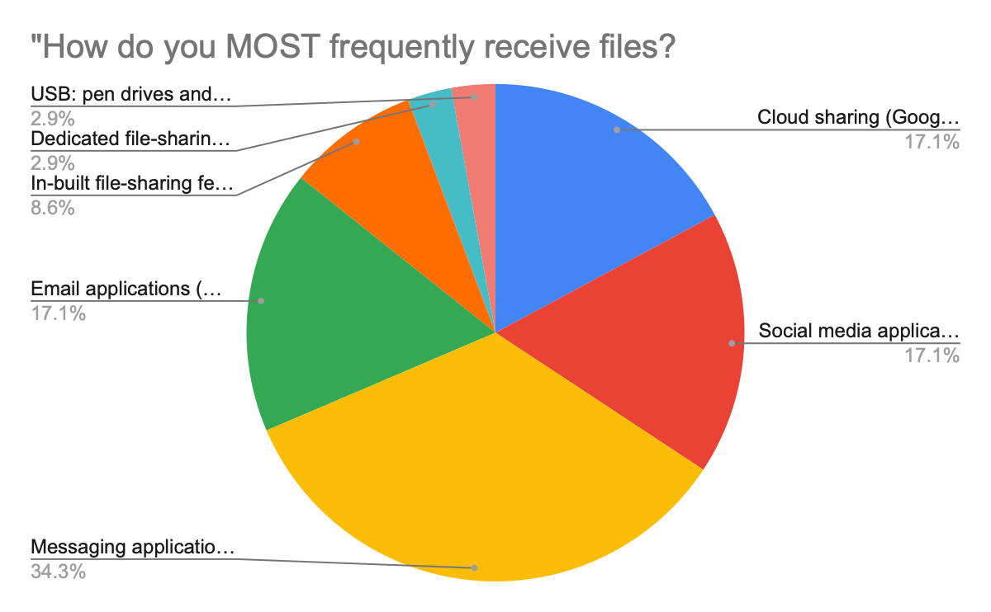
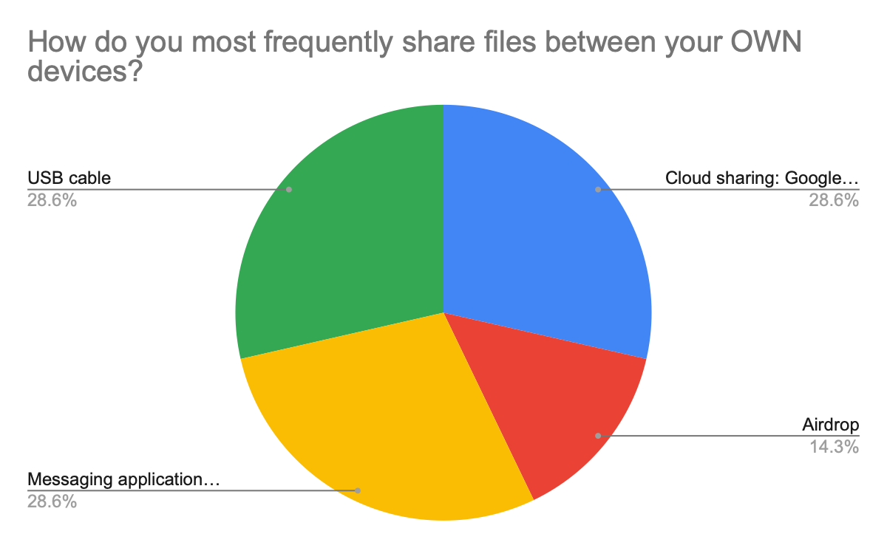
Most frequently receiving mode
Between own devices

Slide 45
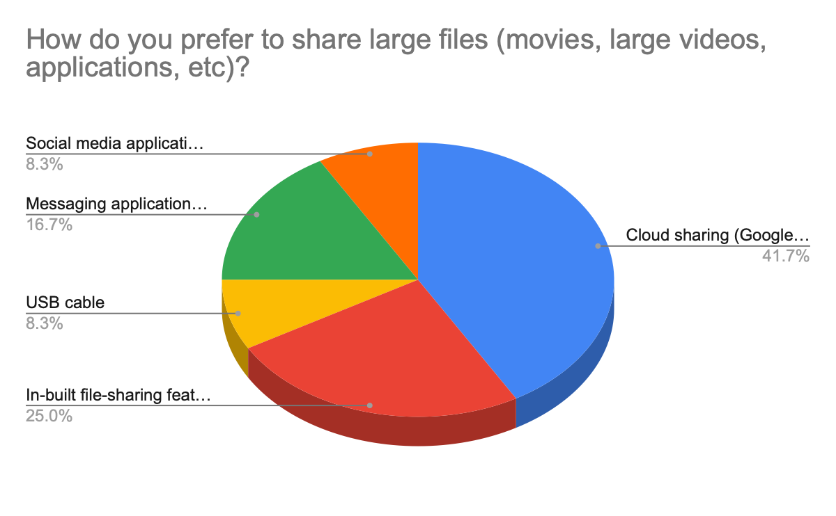
Large file receiving mode

Slide 46
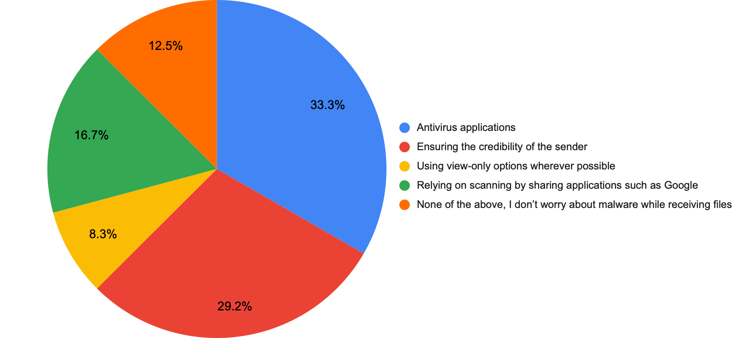
Measures taken to protect device from malware

Slide 47
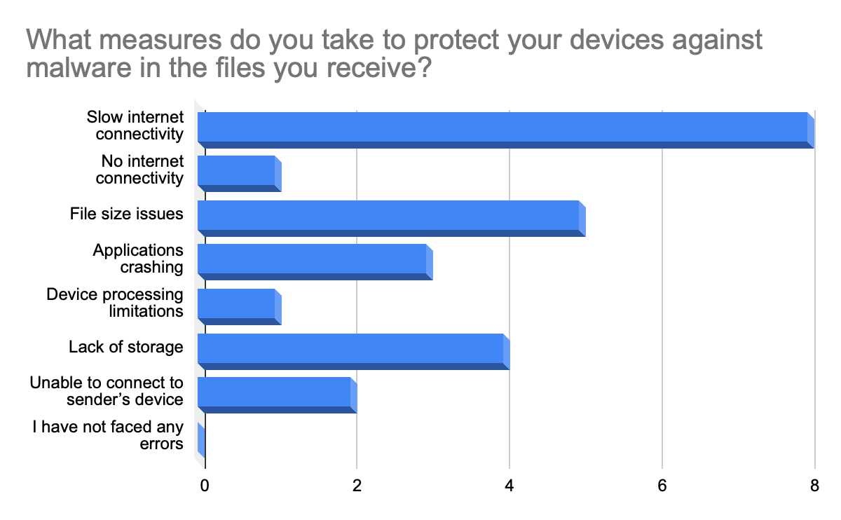
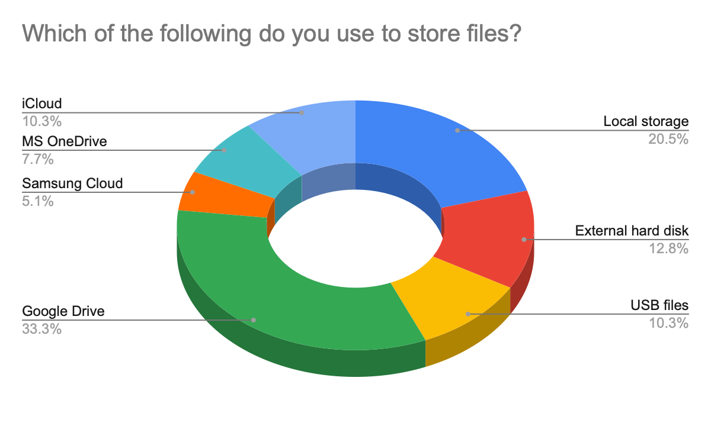
Errors faced while receiving mode
File Storage Habit

Slide 48
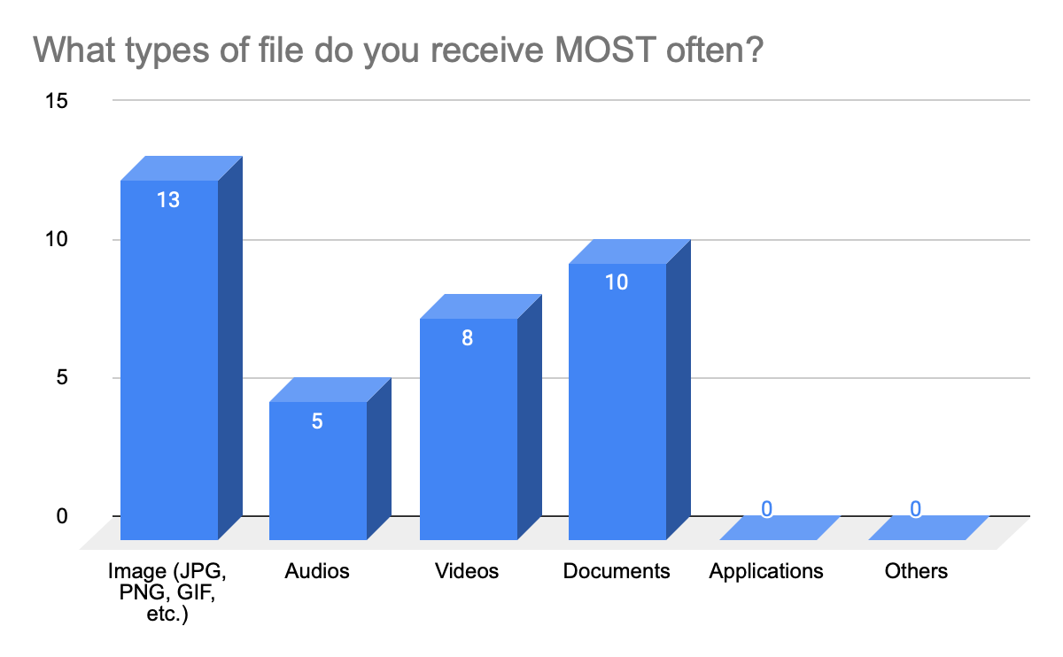
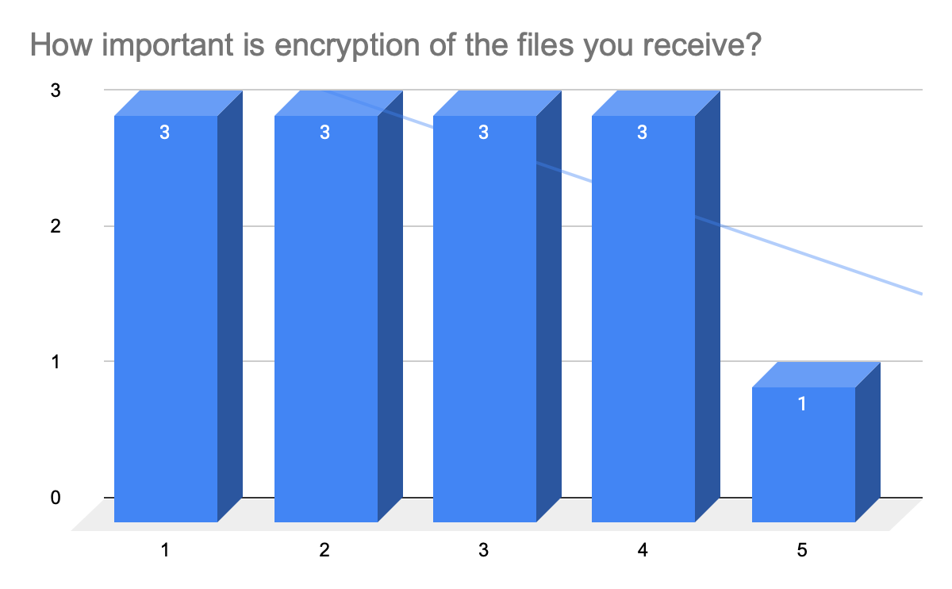
Type of file recieved
Encryption of file recieved
1 - Not important
5 - Very important

Slide 49
Thank You!

